Slide 1
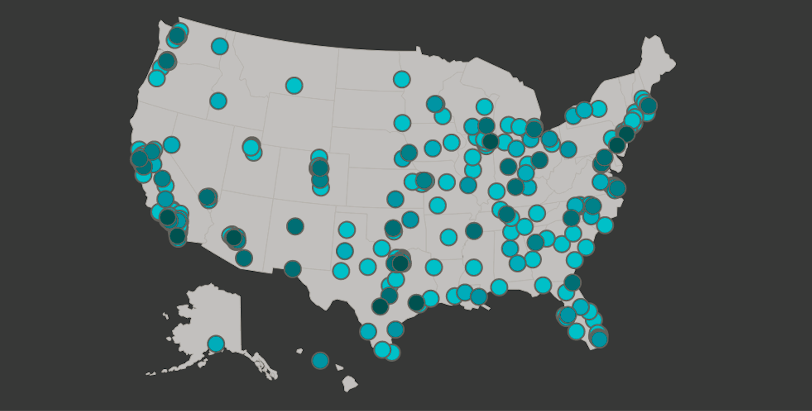
Launch @ Forge - Police Killings (2015) Analysis
Exploring demographic and socioeconomic patterns in U.S. police fatalities
Rabah Babaci - 10/27/2015
Using Python (pandas | matplotlib | seaborn)

Slide 2

What I wanted to Learn
Who are the most affected demographic groups?
Are incidents more common in lower-income or high-poverty areas?
Do some states have higher per-capita rates?
How does being armed/unarmed relate to outcomes?

Slide 3
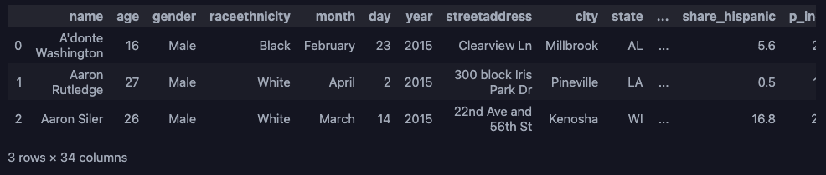
About the Dataset
467 records and 34 columns
Data Source: FiveThirtyEight Police Killings (2015)
Each record includes:
→ person’s name, age, race, city/state, income & poverty data
Covers January-June 2015 (published mid-year)
Cleaning Steps:
Standardized columns → Fixed datatypes → harmonized categories

Slide 4
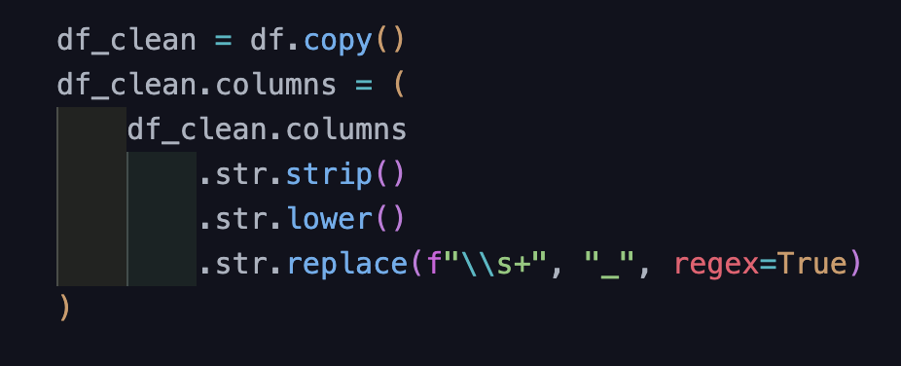
Getting the Data Ready
Standardized column names → lower_snake_case
Converted age/income columns to numeric
Fixed inconsistent month capitalization
Unified race labels (e.g., “Hispanic/Latino” → “Hispanic”)
Added is_armed column (1 = armed, 0 = unarmed)
Cleaned file saved to
data/processed/police_killings_cleans.csv

Slide 5
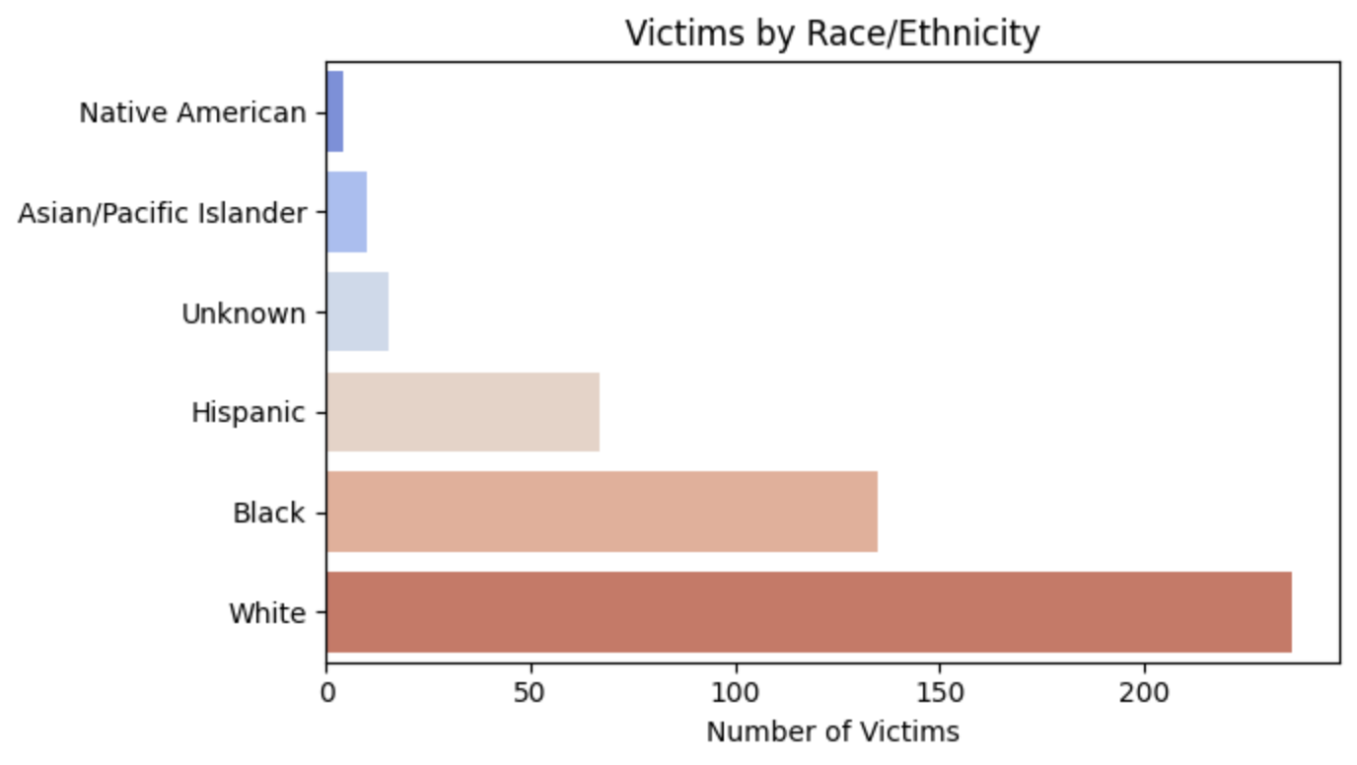
Who Were the Victims?
Most victims were White (236) or Black (135)
Hispanic/Latino (67) followed next
A few were Asian, Native American, or Unknown
“Unknown” values kept to reflect incomplete reporting.

Slide 6
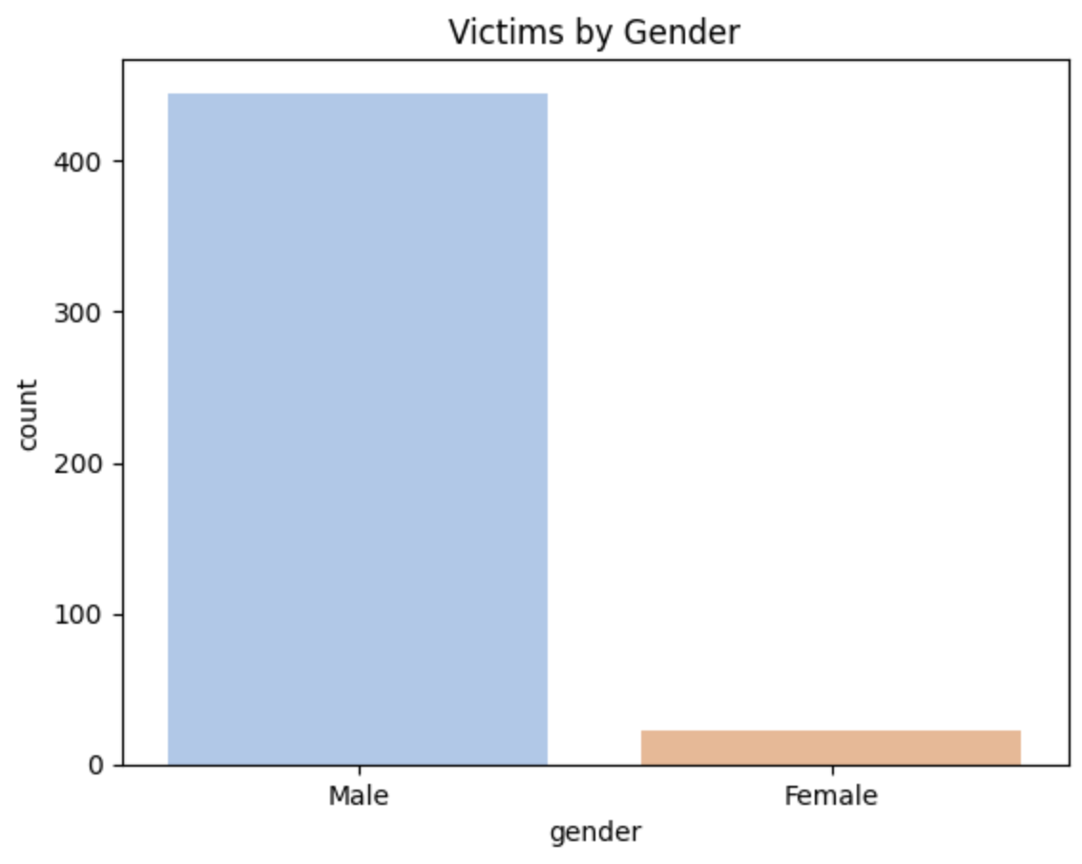
Gender Breakdown
Around 95% of victims were male
22 of 467 were female
Gender imbalance consistent across states

Slide 7
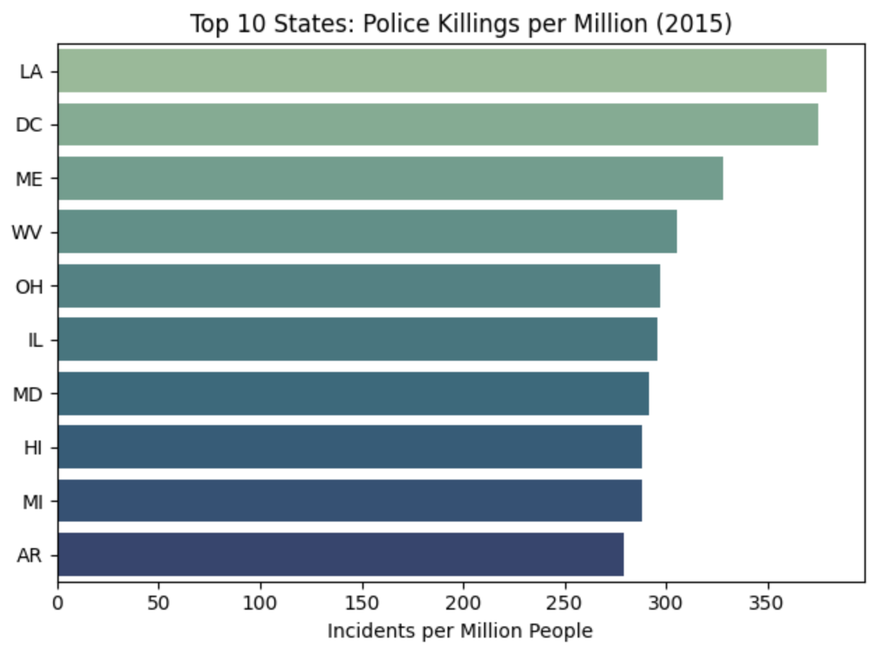
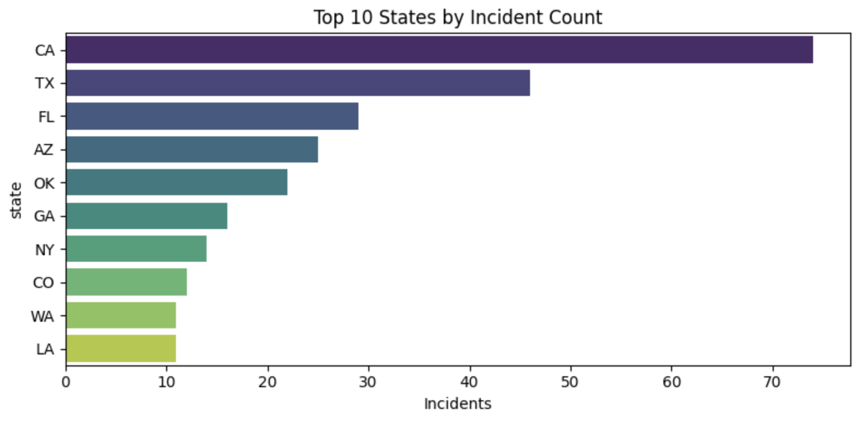
Where Did It Happen Most?
Large states (CA, TX) lead in total incidents
But small states like Louisiana and D.C. rank highest per capita
Shows how population size changes perspective

Slide 8
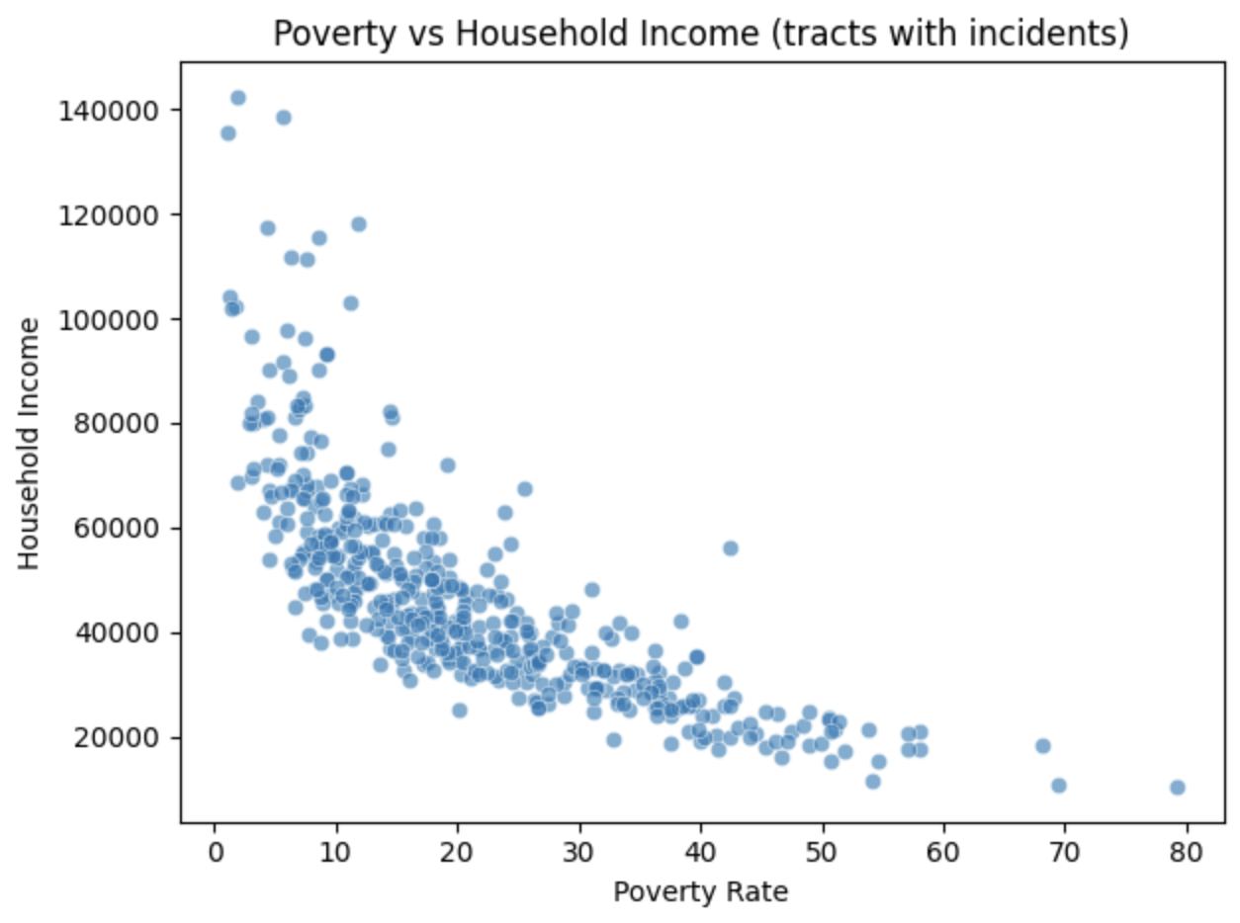
Income and Poverty Patterns
Incidentes often occur in low-income, high-poverty areas
Clear negative trend between income and poverty rate
Suggests economic hardship areas have higher risk exposure

Slide 9
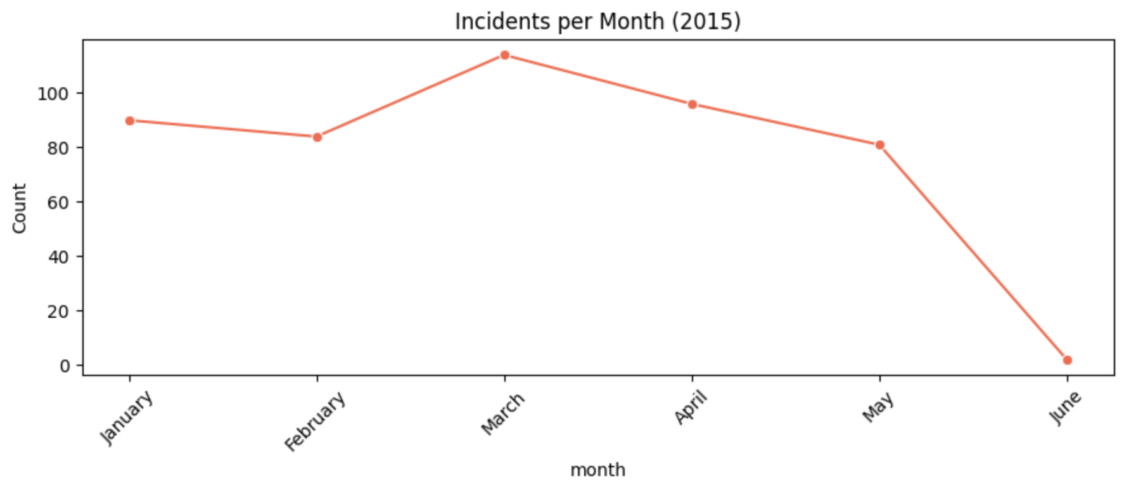
Timeline of Incidents
Data includes Jan-Jun 2025 only
March shows the highest number of incidents
Gradual decline toward early summer. Dataset was released mid-year, so later months weren’t included

Slide 10
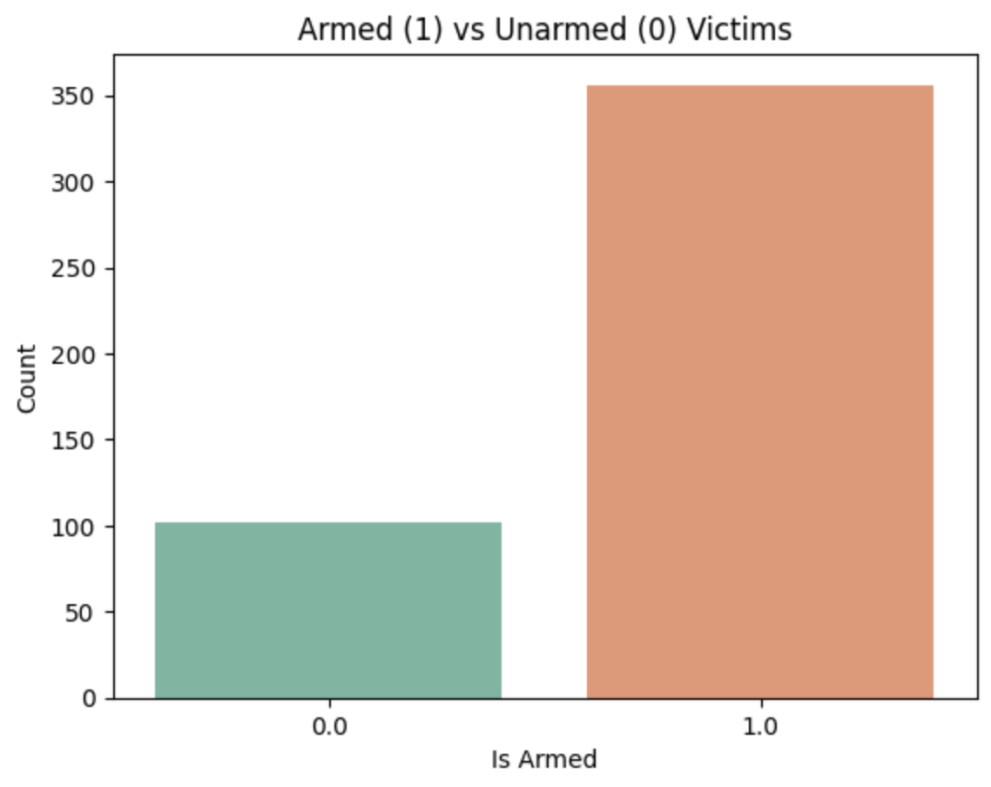
Were Victims Armed?
About 80% were reported as armed
Around 20% were unarmed or unclear
Highlights how context matters in police encounters
“Armed” includes weapons like firearms,
Knives, or vehicles.

Slide 11

Main Insights
Racial imbalance visible (White & Black majorities)
Most victims were male
Incidents cluster in lower-income areas
Smaller states show higher per-capita rates
Data limited to first half of 2015

Slide 12
What I Learned
Learned to clean and explore a real dataset using Python
Practiced using pandas, matplotlib, and seaborn
Saw how normalization (per-capita) changes insights
Understood importance of data completeness and context

Slide 13
References
Data: FiveThirtyEight — Police Killings (2015)
Libraries: pandas, numpy, matplotlib, seaborn
Notebook: analysis.ipynb
Repository: github.com/rabahbabaci/forge-ds-challenge
Prepared for Launch @ Forge Data Science Challenge (2025)

